Slide 1
MS Project
Danny Puype - 2024

Slide 2
Structure
Demo
1. Planning
3. Reporting
Todo’s - WBS
Resources
Links
Info …
2. Tracking
Encoder la réalité
Auto update
Modifier le plan
4. Multi-projects

Slide 3
Environ-nement
Vues / Affichages
Fenêtres
Zoom
Tâches
Tables
Contextuels
WBS
Ligne de temps
Récapitulatives
Soustâches
Contraintes
ASAP
Auto / manual
3 Dimensions
Planning
Baseline
Actual
Divers
QAT
Calcul de base: minutes
Fractionner l’écran
Rubans
Calendriers

Slide 4
Nouveau projet
Préparation: configuration – global.mpt
Date début
Description + but – scope
WBS - structurer
  Tâches récapitulatives
  Sous-tâches
  Jalons
Deadlines / écheances

Slide 5
Liens
Liens
Predecesseurs en Successeurs
Buffer
Liens entre sous tâches / récapitulatives
FS / FD
SS / DD
FF / FF
SF / DF
Méthodes
Raccourci
Formulaire
Champs
Simuler

Slide 6
Mise en format
Texte
Barres
Texte libre
Styles
Styles de Gantt
Styles de barres
Barres individuels
Lignes
Layout
Autres

Slide 7
Ressources
Input
Affectation
Finetuning
Surcharges
? Pourquoi
Travail = Duréé * Capacité
Iron formula
Typologie de tâche
Piloté par effort

Slide 8
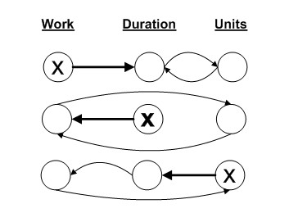
Task type | Work Travail | Duration Durée | Units Capacité
Fixed Work Travail Fixe | Duration Durée | Peak Pointe | Duration Durée
Fixed Duration Durée Fixe | Peak Pointe | Work Travail | Work Travail
Fixed Units Capacité Fixe | Duration Durée | Work Travail | Duration Durée

Slide 9
Tracking / Suivi
Baseline = roadmap
= Encoder ‘Actuals’
  Début / Fin / Durée Réel
  Travail Réel
  Coûts Réels
Comment
  %
  Mettre à jour les tâches
  Formulaire Travail / Coûts
  Table Suivi
  Vues Utilisation Tâches/Ressources
Recalcul du plan
  Evaluer
  ? Mettre à jour

Slide 10
Reporting
Timeline
Print
Export to Office
Excel
Reports
Filters – Grouping

Slide 11
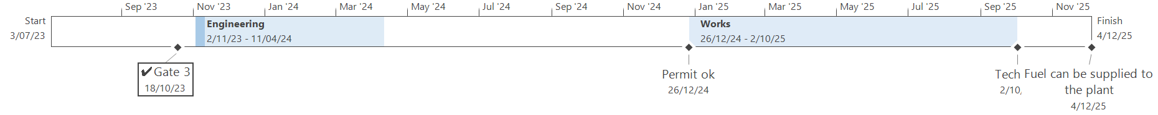

Slide 12
10 insights to ‘crack’ MS Project

Slide 13
1. MS Project is a database
All views and tables show the same data from different perspectives.
The database is built upon 3 axes of main tables:
  Tasks
  Resources
  Assignments
There are tons of fields to customize – get to know them

Slide 14
2. MS Project is a calculator
Everything is recalculated to minutes. And then shown in time-units asper your configuration settings.
In the Options you determine the algorithms to be used in the calendars.

Slide 15
3. Start each project schedule by checking your basic configuration settings
These include your default calendar, the calendar calculations, metadata, currency and time settings.
Use templates to save all settings

Slide 16
4. Let MS Project calculate for you
Let it calculate start and end times for you! Don’t enter dates by default.
The schedule adapts on the basis of the dependencies you’ve set, the durations, task configurations and resource settings.

Slide 17
5. MS Project is programmed to be asap
Don't put constraints initially; if needed put them in when project is ongoing and consider carefully. Beware that changing dates is going to trigger off constraints other than asap or alap.
Use manual tasks if you want to enter dates for tasks and control manually.

Slide 18
6. Use an outline code to discern your task levels and WBS structure
You can use the default one or your own.
Add outline zoom, timescale zoom and other navigation button to the QAT

Slide 19
7. Each of the 3 main (input) fields have three manifestations / versions.
Input happens in duration | work | cost fields
To be able to manage a project you need 3 versions of those fields :
  scheduled
  baseline
  actual
The different versions are shown in different views and tables.

Slide 20
8. Set the timescales to weeks and month for easier management.
The default setting is by days and weeks in most views.
Zooming out the time scale to weeks and months is in many cases a key to handle the project more smoothly; e.g. assessing over-allocation or using time-scaled views.

Slide 21
9. Think in work-terms as much as possible.
Use different time measurements for durations and work. If you prefer to express work in man-days, do so, but then express duration in weeks.
When resources are assigned, a formula (W = D * U ) is triggered off to calculate work.
Each change in one of the parameters of this equation is going to trigger off recalculations in function of
  1) the type of the task (Fixed U, D, W) and
  2) whether the task is effort driven or not.

Slide 22
10. Tracking a project = entering actuals
To track values, search for the appropriate ‘actual’ field and enter the data.

Slide 23
Ressources
MS Project resources
  https://www.youtube.com/watch?v=OuOZVoTwqm8&list=PLe2KBvAeoZPczYIFNd-ZhvHQVwUYJPJKn&index=7&t=2345s : Beginner course
  https://www.youtube.com/watch?v=1vzGD6igNSA&list=PLe2KBvAeoZPczYIFNd-ZhvHQVwUYJPJKn&index=10&t=10s : Advanced course
  http://cnaiman.com/PM/MIT-LabText/2016/MP.2016.Step.by.Step.pdf : Step by Step manual
  https://boyleprojectconsulting.com/tomsblog/browsetitles/using-microsoft-project-msp/ : Tom’s Blog
  Jack Dahlgren’s code & publications: https://www.stakeholdermap.com/ms-project/ms-project-vba.html
  Format Duration macro: https://www.project-systems.co.nz/project-vba-macros/FormatDuration.html
Alternatives
  https://clickup.com/blog/microsoft-project-alternatives/
  https://www.projectlibre.com
  https://monday.com/blog/project-management/the-complete-project-management-software-list/

