Slide 1
PWP-Excel
Data presentaties

Slide 2
Grafieken en tabular Data in PWP

Slide 3
Chart toevoegen in Powerpoint

Slide 4
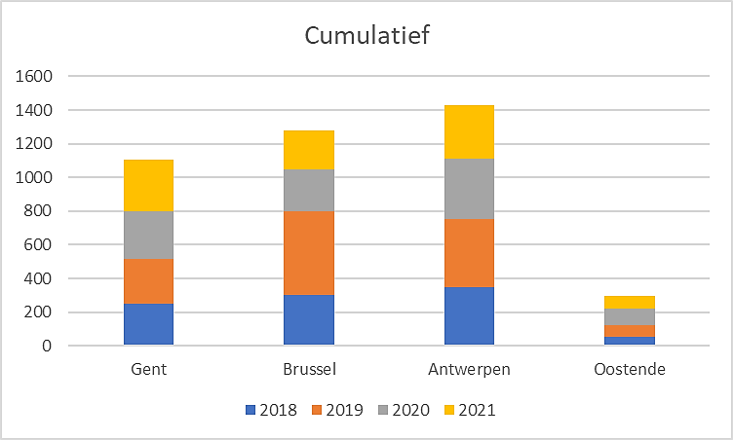
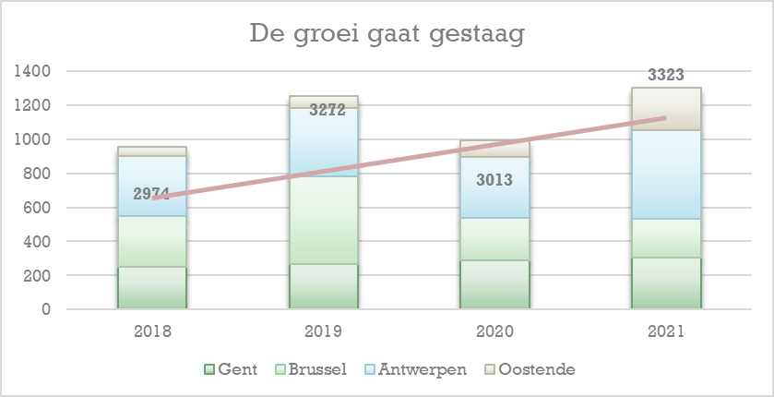
Paste vanuit Excel (als image)

Slide 5
Paste vanuit Excel (met thema keuze)

Slide 6
Paste vanuit Excel (met link naar data)

Slide 7
Paste data vanuit Excel
 | 2018 | 2019 | 2020 | 2021
Gent | 250 | 265 | 286 | 303
Brussel | 300 | 500 | 250 | 229
Antwerpen | 350 | 400 | 359 | 320
Oostende | 56 | 68 | 98 | 450

Slide 8
Animatie van een grafiek

Slide 9
Grafiek met animatie bij klikken op titel

Slide 10
Data communiceren

Slide 11
Betekenisvolle opmaak
Notes:
font size & spacing
color contrasting
removing junk
Adding value
Remove Gridlines and Axis if not necessary
Fade off Axis Labels
Legends are not needed for a single data point
Match the color of Data Labels to the Bars/Lines
Align the Axis Labels Properly
Say NO to unnecessary Borders
Write meaning full Chart Titles
Avoid Indirect Legends

Slide 12
Tabellen en tabular data weergeven
Open tabel opmaak
Leesrichting met banded rows / columns
Aandacht focussen op wat u wilt bespreken
Kies voor grafieken waar mogelijk
 | 2018 | 2019 | 2020 | 2021
Gent | 250 | 265 | 286 | 303
Brussel | 300 | 500 | 250 | 229
Antwerpen | 350 | 400 | 359 | 320
Oostende | 56 | 68 | 98 | 450

Slide 13
Data met grafieken weergeven
Assen benoemen
De waarde van trendlijnen
Kolommen = vergelijken en lijnen = evolutie
Formatteer / animeer die zaken waar de focus op ligt
Overweeg grafische labels
En ook Smart-Arts

Slide 14
Welke chart wanneer?
To compare data across different categories or groups.
Bar Chart
Line Chart
Pie Chart
Area Chart
Column Chart
To compare data across categories. Bars are horizontal instead of vertical.
To display trends or changes over time.
To represent proportions or percentages of a whole.
Scatter Plot
To display the relationship between two numerical variables.
Similar to line charts but to represent accumulated totals over time.
Funnel Chart
Histogram
Histograms are used to visualize the distribution of a dataset.
Waterfall Chart
To illustrate the cumulative effect of positive and negative values on a total.
To visualize a series of stages in a process or sales funnel.
To display hierarchical data using nested rectangles or squares.
Sunburst Chart
Also used to display hierarchical data, similar to treemaps, but in a circular format.
Treemap
Notes:
Column Chart: Column charts are used to compare data across different categories or groups. The height of the columns represents the values being compared.
Bar Chart: Similar to column charts, bar charts are used to compare data across categories. The main difference is that the bars are horizontal instead of vertical.
Line Chart: Line charts are used to display trends or changes over time. They are commonly used to show the relationship between two or more variables and their values at different points.
Pie Chart: Pie charts are used to represent proportions or percentages of a whole. They are particularly effective when showing the relative sizes of different categories.
Scatter Plot: Scatter plots are used to display the relationship between two numerical variables. Each data point is represented by a dot on the graph, and the pattern of dots helps identify any correlation or trend.
Area Chart: Area charts are similar to line charts but with the area below the line filled in. They are often used to represent accumulated totals over time.
Histogram: Histograms are used to visualize the distribution of a dataset. They group data into intervals and display the frequency or count of values falling within each interval.
Waterfall Chart: Waterfall charts are used to illustrate the cumulative effect of positive and negative values on a total. They are commonly used in financial analysis to show the changes in a company's balance sheet or profit and loss statement.
Gantt Chart: Gantt charts are used for project management and scheduling. They display tasks, their start and end dates, and their dependencies, allowing project managers to visualize the timeline and progress of a project.
Funnel Chart: Funnel charts are used to visualize a series of stages in a process or sales funnel. The chart displays the progression or conversion rates from one stage to another, typically starting with a larger number of items or customers at the top and narrowing down to a smaller number at the bottom. Funnel charts are commonly used in sales and marketing to analyze and optimize the sales or conversion process.
Treemap: Treemaps are used to display hierarchical data using nested rectangles or squares. Each rectangle represents a category, and its size corresponds to a quantitative value, such as sales revenue or market share. The treemap allows you to compare the sizes of different categories visually and see the hierarchical relationships between them. Treemaps are useful for visualizing and analyzing complex data structures, such as file sizes in a directory or the allocation of resources in a budget.
Sunburst Chart: Sunburst charts are also used to display hierarchical data, similar to treemaps, but in a circular format. The outer rings represent the main categories, and each subsequent ring represents subcategories or levels within the hierarchy. The size of each sector corresponds to a quantitative value. Sunburst charts are particularly effective in showing the composition and proportions of different categories within a whole. They are commonly used in data analysis, such as analyzing market segments or visualizing organizational structures.

Slide 15
Extra animaties

Slide 16
Credits
ID | Model | Motor | Versnellingsbak | Verbruik | CO2 | Diesel/Benzine
1 | Fabia | 1.2 CRTDI 75pk 89g GreenLine | 5V | 3,4 | 89 | D
2 | Fabia | 1.2 CRTDI DPF 75 pk 99gr | 5V | 3,8 | 99 | D
3 | Fabia | 1.2 HTP 60 pk | 5V | 5,7 | 132 | B
4 | Fabia | 1.2 HTP 70 pk | 5V | 5,5 | 128 | B
5 | Fabia | 1.2 TSI 105 pk | 5V | 5,3 | 124 | B
6 | Fabia | 1.2 TSI 105 pk | DSG7 | 5,3 | 124 | B
7 | Fabia | 1.2 TSI 86 pk | 5V | 5,2 | 121 | B
8 | Fabia | 1.4 TSI 180 pk | DSG7 | 6,2 | 148 | B
9 | Fabia | 1.6 CRTDI DPF 105 pk | 5V | 4,2 | 109 | D
10 | Fabia | 1.6 CRTDI DPF 90 pk | 5V | 4,2 | 109 | D
11 | Fabia Combi | 1.2 CRTDI 75pk 89g GreenLine | 5V | 3,4 | 89 | D
12 | Fabia Combi | 1.2 CRTDI DPF 75 pk 99gr | 5V | 3,8 | 99 | D
13 | Fabia Combi | 1.2 HTP 60 pk | 5V | 5,7 | 132 | B
14 | Fabia Combi | 1.2 HTP 70 pk | 5V | 5,5 | 128 | B
15 | Fabia Combi | 1.2 TSI 105 pk | 5V | 5,3 | 124 | B
16 | Fabia Combi | 1.2 TSI 105 pk | DSG7 | 5,3 | 124 | B
17 | Fabia Combi | 1.2 TSI 86 pk | 5V | 5,2 | 121 | B
18 | Fabia Combi | 1.4 TSI 180 pk | DSG7 | 6,2 | 148 | B
19 | Fabia Combi | 1.6 CRTDI DPF 105 pk | 5V | 4,2 | 109 | D
20 | Fabia Combi | 1.6 CRTDI DPF 90 pk | 5V | 4,2 | 109 | D
21 | Roomster | 1.2 CRTDI 75pk 109g GreenLine | 5V | 4,2 | 109 | D
22 | Roomster | 1.2 CRTDI DPF 75 pk | 5V | 4,5 | 119 | D
23 | Roomster | 1.2 HTP 70 pk | 5V | 6,2 | 143 | B
24 | Roomster | 1.2 TSI 105 pk | 5V | 5,7 | 134 | B
25 | Roomster | 1.2 TSI 105 pk | DSG7 | 5,7 | 134 | B
26 | Roomster | 1.2 TSI 86 pk | 5V | 5,7 | 134 | B
27 | Roomster | 1.6 CRTDI DPF 105 pk | 5V | 4,7 | 124 | D
28 | Roomster | 1.6 CRTDI DPF 90 pk | 5V | 4,7 | 124 | D
29 | Superb Combi | 1.4 TSI 125 pk | 6V | 6,9 | 159 | B
30 | Superb Combi | 1.6 CRTDI DPF 105 pk | 5V | 5,2 | 133 | D
31 | Superb Combi | 1.6 CRTDI DPF 105 pk 114g | 5V | 4,4 | 114 | D
32 | Superb Combi | 1.8 TSI 160 pk | DSG7 | 7,3 | 170 | B
33 | Superb Combi | 1.8 TSI 160 pk | 6V | 7,3 | 171 | B
34 | Superb Combi | 1.8 TSI 160 pk 4X4 | 6V | 8,2 | 191 | B
35 | Superb Combi | 2.0 CRTDI DPF 140 pk | 6V | 5,5 | 145 | D
36 | Superb Combi | 2.0 CRTDI DPF 140 pk | DSG | 6 | 158 | D
37 | Superb Combi | 2.0 CRTDI DPF 140 pk 4X4 | DSG | 6,3 | 166 | D
38 | Superb Combi | 2.0 CRTDI DPF 170 pk | 6V | 5,8 | 151 | D
39 | Superb Combi | 2.0 CRTDI DPF 170 pk | DSG | 6,1 | 159 | D
40 | Superb Combi | 2.0 CRTDI DPF 170 pk 4X4 | 6V | 6,3 | 165 | D
41 | Superb Combi | 2.0 TSI 200 pk | DSG | 8 | 180 | B
42 | Superb Combi | 3.6 FSI V6 260 pk 4X4 | DSG | 10,2 | 237 | B
43 | Yeti | 1.2 TSI 105 pk | 6V | 6,4 | 149 | B
44 | Yeti | 1.2 TSI 105 pk | DSG7 | 6,6 | 154 | B
45 | Yeti | 1.4 TSI 122 pk | 6V | 6,8 | 159 | B
46 | Yeti | 1.6 CRTDI 105pk 119g GreenLine | 5V | 4,6 | 119 | D
47 | Yeti | 1.8 TSI 160 pk 4X4 | 6V | 8 | 189 | B
48 | Yeti | 2.0 CRTDI DPF 110 pk | 5V | 5,4 | 140 | D
49 | Yeti | 2.0 CRTDI DPF 110 pk 4X4 | 6V | 6,1 | 159 | D
50 | Yeti | 2.0 CRTDI DPF 140 pk 4X4 | 6V | 6 | 157 | D
51 | Yeti | 2.0 CRTDI DPF 140 pk 4X4 | DSG | 6,5 | 169 | D
52 | Yeti | 2.0 CRTDI DPF 170 pk 4X4 | 6V | 5,9 | 155 | D
53 | Octavia Berline | 1.2 TSI 105 pk | 6V | 5,7 | 134 | B
54 | Octavia Berline | 1.2 TSI 105 pk | DSG7 | 5,9 | 136 | B
55 | Octavia Berline | 1.4 MPI 80 pk | 5V | 6,4 | 149 | B
56 | Octavia Berline | 1.4 TSI 122 pk | DSG7 | 6,3 | 147 | B
57 | Octavia Berline | 1.4 TSI 122 pk | 6V | 6,3 | 148 | B
58 | Octavia Berline | 1.6 CRTDI 105pk 99g GreenLine | 5V | 3,8 | 99 | D
59 | Octavia Berline | 1.6 CRTDI DPF 105 pk | 5V | 4,5 | 119 | D
60 | Octavia Berline | 1.6 CRTDI DPF 105 pk | DSG7 | 4,7 | 123 | D
61 | Octavia Berline | 1.6 CRTDI DPF 105 pk 109gr CO² | 5V | 4,2 | 109 | D
62 | Octavia Berline | 1.8 TSI 160 pk | DSG7 | 6,6 | 155 | B
63 | Octavia Berline | 1.8 TSI 160 pk | 6V | 6,9 | 158 | B
64 | Octavia Berline | 2.0 CRTDI DPF 140 pk | 6V | 4,8 | 126 | D
65 | Octavia Berline | 2.0 CRTDI DPF 140 pk | DSG | 5,3 | 138 | D
66 | Octavia Berline | 2.0 CRTDI DPF 170 pk | 6V | 5,7 | 149 | D
67 | Octavia Berline | 2.0 CRTDI DPF 170 pk | DSG | 6 | 159 | D
68 | Octavia Berline | 2.0 TSI 200 pk | 6V | 7,5 | 175 | B
69 | Octavia Berline | 2.0 TSI 200 pk | DSG6 | 7,7 | 180 | B
70 | Octavia Combi | 1.2 TSI 105 pk | 6V | 5,7 | 134 | B
71 | Octavia Combi | 1.2 TSI 105 pk | DSG7 | 5,9 | 136 | B
72 | Octavia Combi | 1.4 TSI 122 pk | DSG7 | 6,3 | 147 | B
73 | Octavia Combi | 1.4 TSI 122 pk | 6V | 6,3 | 148 | B
74 | Octavia Combi | 1.6 CRTDI DPF 105 pk | 5V | 4,5 | 119 | D
75 | Octavia Combi | 1.6 CRTDI DPF 105 pk | DSG7 | 4,7 | 123 | D
76 | Octavia Combi | 1.6 CRTDI DPF 105 pk | 4X4 | 5,4 | 141 | D
77 | Octavia Combi | 1.6 CRTDI DPF 105 pk 109gr CO² | 5V | 4,2 | 109 | D
78 | Octavia Combi | 1.6 MPI 102 pk | 5V | 7,2 | 168 | B
79 | Octavia Combi | 1.8 TSI 160 pk | DSG7 | 6,6 | 155 | B
80 | Octavia Combi | 1.8 TSI 160 pk | 6V | 6,9 | 158 | B
81 | Octavia Combi | 1.8 TSI 160 pk 4X4 | 6V | 7,7 | 180 | B
82 | Octavia Combi | 2.0 CRTDI DPF 140 pk | 6V | 4,9 | 129 | D
83 | Octavia Combi | 2.0 CRTDI DPF 140 pk | DSG | 5,4 | 143 | D
84 | Octavia Combi | 2.0 CRTDI DPF 140 pk 4x4 | 6V | 5,6 | 148 | D
85 | Octavia Combi | 2.0 CRTDI DPF 140 pk 4X4 | DSG | 5,9 | 156 | D
86 | Octavia Combi | 2.0 CRTDI DPF 170 pk | 6V | 5,7 | 149 | D
87 | Octavia Combi | 2.0 CRTDI DPF 170 pk | DSG | 6 | 159 | D
88 | Octavia Combi | 2.0 TSI 200 pk | 6V | 7,5 | 175 | B
89 | Octavia Combi | 2.0 TSI 200 pk | DSG6 | 7,7 | 180 | B
90 | Superb | 1.4 TSI 125 pk | 6V | 6,8 | 157 | B
91 | Superb | 1.6 CRTDI 105pk 114g GreenLine | 5V | 4,4 | 114 | D
92 | Superb | 1.6 CRTDI DPF 105 pk | 5V | 5 | 130 | D
93 | Superb | 1.8 TSI 160 pk | DSG7 | 7,1 | 168 | B
94 | Superb | 1.8 TSI 160 pk | 6V | 7,2 | 169 | B
95 | Superb | 1.8 TSI 160 pk | 4X4 | 8,1 | 189 | B
96 | Superb | 2.0 CRTDI DPF 140 pk | 6V | 5,4 | 143 | D
97 | Superb | 2.0 CRTDI DPF 140 pk | DSG | 5,9 | 154 | D
98 | Superb | 2.0 CRTDI DPF 140 pk 4X4 | DSG | 6,2 | 162 | D
99 | Superb | 2.0 CRTDI DPF 170 pk | 6V | 5,7 | 149 | D
100 | Superb | 2.0 CRTDI DPF 170 pk | DSG | 6 | 157 | D
101 | Superb | 2.0 CRTDI DPF 170 pk | 4X4 | 6,2 | 163 | D
102 | Superb | 2.0 TSI 200 pk | DSG | 7,9 | 178 | B
103 | Superb | 3.6 FSI V6 260 pk 4X4 | DSG | 10,1 | 235 | B

Slide 17
Zijdelings

Slide 18
Effecten zonder Excel of charts
2018
2019
2020

