Slide 1
Outlook
Beyond basics
Time management
Tips & tricks
Danny Puype
Trainer / Developer
danny@puype.com

Slide 2
Managing outlook & time

Slide 3
Course overview
Outlook
Environment
Automate
Rules / Quicksteps / Templates / Quickparts / Autotext / Archive / …
Structure
Flags / Categories / Grouping and Sorting / Views / Conditional format / …
Searching
Quick find / Advanced search / Search folders
Agenda & Contacts
the concept, a multifolder system, .pst files
QAT, views, panels, options, favorites
Planning, meetings, share agenda, manage contacts
Tips and Tricks
Tasks
Use, delegation
Tools
Add-ins, export/import, compacting,

Slide 4
Some Strategies
Clean out your inbox every day & use ‘to handle folder’
Close Outlook when possible and open only at certain times
Organise folders as your windows folders
Categorize and flag and colour
Remove and store attachments as much as possible
Take notes and use tasks
4 D’s
Rules and quicksteps
Favorites
Search folders
Tasks and delegated tasks
Mail to yourself
Use customized views
Format conditionally
List, group by, categorize
Swith off prompts
Automize
Quick parts & signatures
Templates
Quick clics
Task sequences
Conversation view
Use compressed multimedia
Turn off reading pane
Quick Access toolbar
Simplify
Unfollow conversations
Unsubscribe
Reduce cc:
Use another way / tool
1thing at the time
One Note
Use links instead
Dictate your messages
Create your own

Slide 5
Some Strategies 1
Clean out your inbox every day & use ‘to handle folder’
Close Outlook when possible and open only at certain times
Organise folders as your windows folders
4 D’s
Rules and quicksteps
Favorites
Search folders
Swith off prompts
Turn off reading pane

Slide 6
Some Strategies 2
Categorize and flag and colour
Use customized views
Format conditionally
List, group by, categorize
Conversation view
Create your own
Quick Access toolbar
Automize
Quick parts & signatures
Templates
Quick clics
Task sequences
Dictate your messages

Slide 7
Some Strategies 3
Take notes and use tasks
Tasks
Mail to yourself
Use compressed multimedia
Simplify
Unfollow conversations
Unsubscribe
Reduce cc:
Use another way / tool
1thing at the time
One Note
Use links instead
Remove and store attachments as much as possible
Delegated tasks

Slide 8
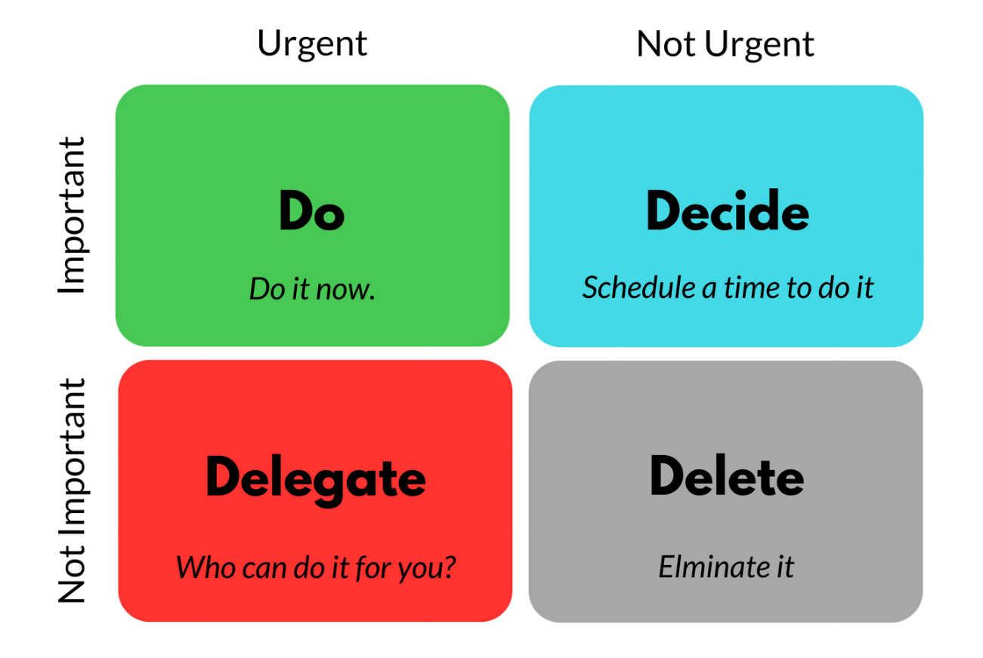
The Eisenhower decision matrix
Notes:
TTC: Toucher-Traiter-Classer
•Traitez vos messages en utilisant les 4 D. Lorsque vous lisez un message, prenez l'une des décisions suivantes:
•Détruisez-le.
•Donnez-y suite immédiatement(répondez-y ou classez-le à des fins de référence).
•Déléguez-le(transfert).
•Différez-le pour une deuxième lecture en l'envoyant dans votre liste de tâches.(à l'aide de catégories et d'indicateurs)

Slide 9
Sorting, Grouping, Labeling

Slide 10
Do , Decide, Delegate, Delete
Save contact
Print
Forward, reply
Create meeting or rdv
Phone – set a flag
Create task/job
Delegate a task

Slide 11
TTC: Toucher-Traiter-Classer
Détruisez-le.
Donnez-y suite immédiatement
Déléguez-le(transfert).
Différez-le

Slide 12
User friendly-ness
Write precise subject descriptions
Write clear and to the point messages
Limit copying, forwarding, reply to all
Limit the number of attachments – use zip
Tag your messages and invites
Consider expiration on messages
Change subject if topic changes
When action needed, stipulate it in subject
Re-read
Put important elements in bold

Slide 13
Communication
Utilisez un objet descriptif et concret.
Ecrivez des message clairs et to the point
Envoyez des liens au lieu d’attachs
Tag your messages and invites
Considérer expiration des messages
Modifiez l'objet du message si le sujet de la conversation
Si une action est requise, stipulez le dans le objet
Relisez avant d’envoyer
Limitez Cc:, Re: to all, forwards
Mettez les éléments importants en gras
Notes:
Lisez votre message avant de l'envoyer.
•Si vous voulez une réponse immédiate, n'envoyez pas de message. Téléphonez ou envoyez un message instantané.
•Si votre conversation par courrier électronique comporte plus de 10 messages sans qu’une solution ait été trouvée, envisagez d’organiser une réunion pour en discuter.
•Accusez réception des messages qui requièrent une réponse plus approfondie.
•Faites savoir à l'expéditeur que vous examinez le problème et que vous répondrez dans un certain délai ou à une certaine date. Ajoutez un indicateur pour ne pas oublier d'y revenir plus tard.

Slide 14
Tips and tricks

Slide 15
Tips and Tricks Topics
Sending mail
Receiving & Manage mails
Searching mail
Folders and views
Format
Attachments
Calendar
Contacts & Tasks
Configuration
Shortcuts

Slide 16
Sending mail
Bcc: field
Recall a message
Resend a message
Options to html/text/rtf mail
Ctrl+K to search contact and obtain suggestions
Suggestions of names: remove names & import from *,nk2 file
Sending messages to categorized contacts
Delayed delivery – rule for delayed delivery
Replies to another account via delivery options, or via From field
Automatically Cc: All Mail You Send in Outlook with rule
Voting buttons
Automatically close emails after replying or handling
Add signatures
Use of quick parts / autotext
Ctrl + Enter to send mail
http://verify-email.org/ to check mailbox existence
Using templates
Notes:
/application Data/outlook : nk2 file

Slide 17
Receiving & Manage mails
F9 – send and receive
Drag and drop a mail to another folder
Save as file, msg format – multiple messages to folder
Quick click to follow up or to allocate categories
Highlight messages that have only you in the To: line. – conditional formatting
Add reminder
Permanently delete mails right away with SHFT
Mark as read after x seconds ; navigation pane options
Assign categories through rules
Rules on out of office
Auto Archive
Print part of a mail – edit the mail first
Ctrl-Shft+V : short cut to move folders
Quicksteps
Buttons to automatically move messages to folders (VBA)

Slide 18
Searching mail
Use search folders
Find mails from same sender
F4 to search in mail’s content (Find)
Find Related Messages
Search operators: AND, OR, NOT, “”
Activate indexation

Slide 19
Folders and views
Use of *pst or data files & *ost files
Create a customized view
Arrange view by conversation
Alt-F1 : navigation pane on/off
Sort on multiple fields
Expand and collapse folders with * and – (num keyboard)
Use of group by box - autogroup
Use Favorite folders list
Sort folders your way with numbers or symbols
Shortcut to templates
Compact folders
Quick Click
Right click shortcuts on navigation panel to open new window

Slide 20
Format & auto content
Default html mail format – folder - stationary
Use of a template with format
Mark messages with comments
Automatically format in views
(eg mails sent to me only)
HTML signature
Change wrap settings on outgoing mails
Get rid of background on received messages
Use Autocorrect Option to generate content
Use Quickparts
Notes:
XP => C:\Program Files\Common Files\MicrosoftShared\Stationery
Vista => C:\Program Files\Common Files\MicrosoftShared\Stationery
XP => C:\Documentsand Settings\Uti\ApplicationData\Microsoft\Signatures
Vista => C:\Users\Uti\AppData\Roaming\Microsoft\Signatures
Html signature:
Pour XP ==> C:\Documents and Settings\"UTI"\Application Data\Microsoft\Signatures\
Pour Vista ==> C:\Users\"UTI"\AppData\Roaming\Microsoft\Signatures\

Slide 21
Attachments
Save many attachments and separate them
Attach a mail item
Drag and drop many files from Win Explorer
Download only headers for big messages
Attachments which are blocked
Insert & save inline pictures
Notes:
HKEY_CURRENT_USER/software/Microsoft/Office/xx.x/Outlook/Security xx.x est le numéro de votre version Office.
9.00 = office 2000 10.0 = office 2002 11.0 = office 2003 12.0 = office 2007
Repérez la clef Level1Remove, si elle n'existe pas créez-la. Elle est de type Reg_SZ Saisissez les extensions que vous
souhaitez accepter comme ceci :
.ext;
Pour accepter les ZIP, EXE et TXT tapez :
.zip;.exe;.txt;
Software:
Attachment Options addin: www.slovaktech.com (2007)
Codetwo Attach Unlocker : www.codetwo.com (2010)

Slide 22
Calendar
Ctrl-G, goto date (2 weeks, 1st Monday of may)
Change time intervals
Automatic colour meetings and rdv’s
Calendar overlays
Create a calendar group
Show week numbers
Add Holidays for different zones & Delete Holidays
Print an empty calendar
Send calendar as email
View any number of days: ALT+Nr on main keypad
View non consecutive days
Hide private appointment details when printing
Export Calendar to Excel
To do bar & nr of calendars

Slide 23
Contacts & Tasks
Make contacts folder appear in outlook address book
Quickly add an email address to the Contacts
Search contact
Send mail to grouped contacts
Add search contacts to QAT
Export / import contacts with pst
Drag and drop mail to task folder icon
View tasks by assignment
Task list stored in pst
Assign tasks
Link tasks to OneNote

Slide 24
More Shortcuts
Alt-F1 : navigation panel
Alt-F2 : To Do bar
Ctrl-Shift-I: Switch to in-box.
Ctrl-Shift-O: Switch to out-box.
Ctrl-Enter: Send current message.
Ctrl-R: Reply to a message
Ctrl-Shift-R: Reply All to a message
Ctrl-Shift-A: New appointment
Ctrl-N: Create a new message (Ctrl-Shft-M)
Alt+S: Send
F3 : Search
F9 : Send/Receive
Alt+ nr days in calendar
Ctrl+G : goto Date
Ctrl+Shift+F1: min/max ribbons
Ctrl-1: Switch to Mail
Ctrl-2: Switch to Calendar
Ctrl-3: Switch to Contacts
Ctrl-4: Switch to Tasks
Ctrl-5: Switch to Notes
Ctrl-6: Switch to Folder list
Ctrl-7: Switch to Shortcuts

Slide 25
Configuration
Use of QAT bar
Multiple PCs – accounts to ‘leave messages on server’
Open outlook in a different folder
Export / import rules
Configuration of multiple profiles
Include / exclude accounts from sending and receiving (groups)
Use of favorites
Outlook with special shortcuts (switch) to launch program : "C:\Program Files\Microsoft Office\Office12\OUTLOOK.EXE" /finder
Find out where Outlook stores pst files
Setup Gmail in Outlook
Move a pst file
Disable unnecessary addins
Reading pane options
Notes:
XP => C:\Documentsand Settings\Uti\ApplicationData\Microsoft\Outlook
Vista => C:\Users\Uti\AppData\Roaming\Microsoft\Outlook
VbaProject.OTM
XP => C:\Documentsand Settings\Uti\ApplicationData\Microsoft\Outlook
Vista => C:\Users\Uti\AppData\Roaming\Microsoft\Outlook
Outlook switches
/cleancategories Supprime tous les noms de catégorie personnalisée que vous avez créés. Réattribue les noms par défaut aux catégories.
/cleanclientrules Démarre Outlook et supprime les règles basées sur le client.
/cleandmrecords Supprime les enregistrements de connexion enregistrés lorsqu'un responsable ou un délégué décline une réunion.
/cleanfinders Supprime les dossiers de recherche du magasin Microsoft Exchange Server.
/cleanfreebusy Efface et régénère les informations de disponibilité. Ce commutateur ne peut être utilisé que lorsque vous pouvez vous connecter à votre ordinateur Exchange Server.
/cleanprofile Supprime les clés de profil non valides et crée de nouveau les clés de registre par défaut, dès que cette opération est possible.
/cleanreminders Efface et régénère les rappels.
/cleanrules Démarre Outlook et supprime les règles basées sur le client et sur le serveur.
/cleanserverrules Démarre Outlook et supprime les règles basées sur le serveur.
/cleanviews Restaure les affichages par défaut. Tous les affichages personnalisés que vous avez créés seront perdus.
/finder Ouvre la boîte de dialogue Recherche avancée.
/nopreview Démarre Outlook avec le volet de lecture désactivé.
/profiles Ouvre la boîte de dialogue Choix d'un profil indépendamment du paramètre Options dans le menu Outils.
/resetfolders Restaure les dossiers manquants à l'emplacement de remise par défaut.
/resetfoldernames "Redéfinit les noms de dossier par défaut (tels que Boîte de réception ou Éléments
envoyés) en utilisant les noms par défaut dans la langue d'interface utilisateur Office en cours. Si, par exemple, vous vous connectez d'abord à votre boîte aux lettres dans Outlook à l'aide d'une interface utilisateur en russe, les noms du dossier par défaut russe ne peuvent être renommés. Pour modifier les noms de dossier par défaut en une autre langue, telle que le japonais ou l'anglais, vous pouvez utiliser ce commutateur pour redéfinir les noms de
dossier par défaut après la modification de la langue d'interface utilisateur ou après l'installation d'une version d'Outlook dans une autre langue.«
/safe Démarre Outlook sans les extensions client Microsoft Exchange Server (ECE), le volet de lecteur ou les personnalisations de la barre d'outils. Les compléments COM (Component Object Model) sont désactivés.
/importnk2 : import nk2 suggested emails to suggested folder in Outlook 2010
Access Gmail with Outlook Using IMAP
To set up seamless access to all your Gmail mail and labels in Outlook 2007 (you can also access Gmail with Outlook 2002 or 2003):
Make sure IMAP access is enabled in Gmail.
Select Tools | Account Settings... from the menu in Outlook. Go to the E-mail tab. Click New....
Make sure Microsoft Exchange, POP3, IMAP, or HTTP is selected. Click Next >.
Type your name (what you want to appear in the From: line of messages you send) under Your Name:.
Enter your full Gmail address under E-mail Address:. Make sure you include "@gmail.com". If your Gmail account name is "asdf.asdf", make sure you type "asdf.asdf@gmail.com" (not including the quotation marks), for example.
Make sure Manually configure server settings or additional server types is checked. Click Next >.
Make sure Internet E-mail is selected. Click Next >.
Select IMAP under Account Type:.
Type "imap.gmail.com" under Incoming mail server:.
Enter "smtp.gmail.com" under Outgoing mail server (SMTP):.
Type your Gmail account name under User Name:. If your Gmail address is "asdf.asdf@gmail.com", for example, type "asdf.asdf".
Type your Gmail password under Password:. Click More Settings ....
Go to the Outgoing Server tab. Make sure My outgoing server (SMTP) requires authentication is checked.
Now go to the Advanced tab. Select SSL under Use the following type of encrypted connection: for both Incoming server (IMAP): and Outgoing server (SMTP):. Type "465" under Server Port Numbers for Outgoing server (SMTP):. Click OK.
Now click Next >. Click Finish. Click Close.

Slide 26
Annexes

Slide 27
Tools & Resources
Error handling & debugging pst folders with scanpst.exe
General support & Business use
  http://www.slipstick.com/
  http://www.standss.com/blog/
  https://www.howto-outlook.com/
  https://www.msoutlook.info/
Microsoft General
  https://support.microsoft.com/nl-nl/outlook
  https://support.microsoft.com/fr-fr/outlook
Searching
  https://www.howto-outlook.com/howto/searchcommands.htm
  https://support.microsoft.com/en-us/office/learn-to-narrow-your-search-criteria-for-better-searches-in-outlook-d824d1e9-a255-4c8a-8553-276fb895a8da
Notes:
Pour Outlook 2007
F:\Program Files\Microsoft Office\Office12\scanost.exe
F:\Program Files\Microsoft Office\Office12\scanpst.exe
Pour Outlook 2003
C:\Program Files\Fichiers communs\System\MSMAPI\1036\scanpst.exe
C:\Program Files\Fichiers communs\System\MSMAPI\1036\scanost.exe
Pour cela il vous faut activer les dossiers cachés :
-> Dans l'explorateur de Windows -> Outils -> Options des dossiers... -> Onglet Affichage -> Cliquez sur afficher Show
hidden files and folders

Slide 28
Questions and answers
file messages with one click?
streamline conversations?
delete and mute a conversation ?
create and use an email template?
find related messages?
search inside a message?
find all mail from a sender quickly?
schedule emails?
highlight mail sent to you only?
change the default font face and size ?
automatically cc: all mail you send in outlook
expand outlook with time-saving add-ons?
send text messages from within Outlook?

Slide 29
Recurrent task
Review calendar for today and tomorrow
Review appointments you had today and any action items
Review tomorrow’s appointments to determine any preparation necessary
Review tasks for today and tomorrow
  What are your high priority tasks that need attention before you leave today?
  Do you have any tasks that need to be re-prioritised?
  What new tasks have a due date for tomorrow?
Schedule time for priority tasks:
  Block time on your calendar by left dragging a priority task to an appropriate time
  Look over your Inbox
  Apply the 4Ds, gauge how much time you need to clear your Inbox, and schedule this time before you leave the office
Review your accomplishments
Reflect on what went well today
Recognize anyone who exceeded your expectations today
Note these achievements so that you can recall them later

Slide 30
Strategies
Clean out your inbox every day & use ‘to handle folder’.
  Try to handle e-mail message only once – by making a decision based on 4 Ds: Delete it | Delegate it | Do it (now – if less than a few minutes) | Defer it (add to “To-Do” list)
  Use rules to sort mail that you don’t need to read immediately into folders as it arrives and use quick steps.
Close Outlook when possible and open only at certain times.
  Shut down ‘new messages’ prompts.
  Turn off the Reading Pane if you have lots going on.
Organise folders as your windows folders
  If you have lots of e-mail, consider using multiple .pst files to separate information into separate data stores.
  Set favorite folders for easy access
  Use search folders
Categorize and flag and colour.
Remove and store attachments as much as possible.
Take notes
  Note things to do as tasks.
  Send yourself email e.g. with ‘not to forget’.
Take some time to create custom views.

