Slide 1
Pivot tables
Draaitabellen
Tableaux croisés dynamiques
Danny Puype – Trainer/Developer
danny@puype.com

Slide 2
Program
Lists and tables – source data
Pivottable creation
Analysing the data
Pivotchart creation
Calculations
Grouping
Advanced settings and options
Creating a dashboard
Using the data model with PowerPivot

Slide 3
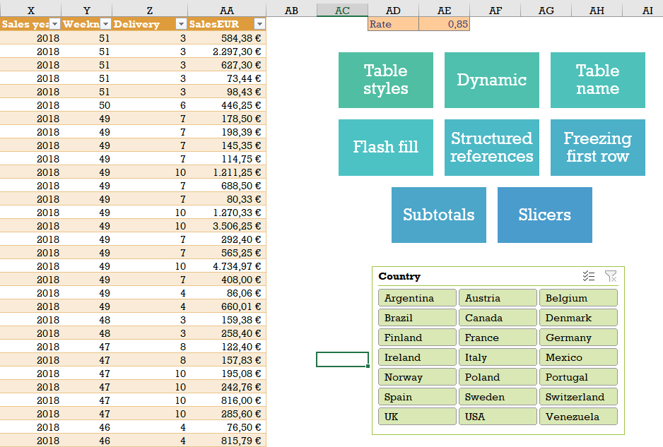
Lists and tables – source data
Data structure
Advantages of using tables
Subtotals
Alternative functions
Sumifs(), Sumproduct(), Filter()

Slide 4
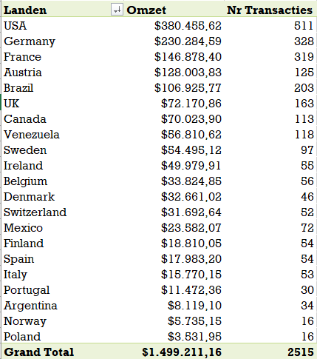
Pivottable creation
4 sections
Adding and formatting fields
Pivot cache
Updating source data
Formatting and styles
Options
Multiple dimensions

Slide 5
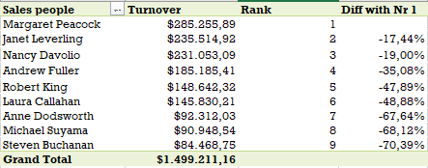
Analysing the data
Sorting and filtering
Aggregations
Report filters
Groeping of dates, numbers, values
Showing the details
Slicers and timeline
Totals and subtotals
Conditional formatting

Slide 6
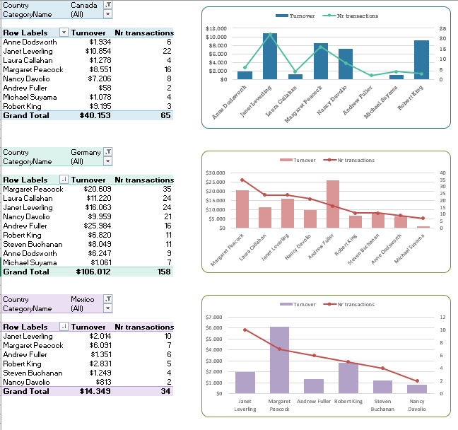
Pivotchart creation
Adding a pivot chart
Templates
Chart types and options
Formatting charts
Modifying and adding elements

Slide 7
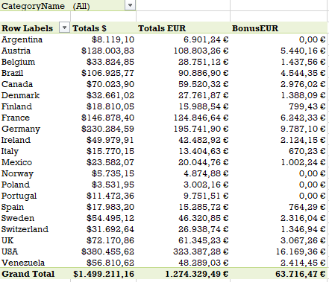
Advanced settings and options
Calculated fields
GetPivotTableData
Calculated items
Calculations with %
Pivottables with new pivotable cache
Pivottable with external sources

Slide 8
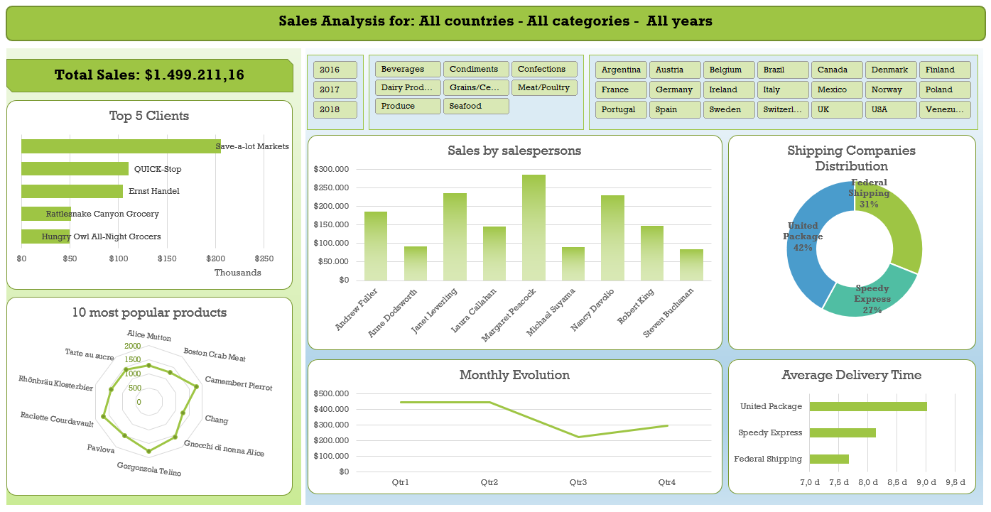
Creating a dashboard

Slide 9
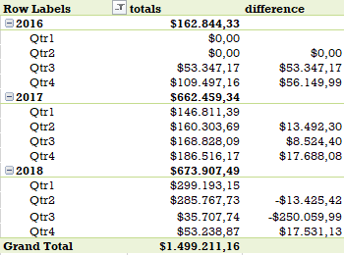
Interesting options and configurations – problem solving
Autofit Columns
Reportfilters in columns
Not showing deleted items
Count in stead of Sum
Multiple filters
Empty cells and errors
Hide source data
Default settings
Show empty/all items

Slide 10

Using the data model with PowerPivot
Power pivot and the datamodel
The datamodel window
Creating relationships between tables
Extra features when using datamodel
Adding tables to the data model
Pivottable based on data model

Slide 11
Interesting sources
EN
  https://www.contextures.com/pivottableindex.html
  https://www.myonlinetraininghub.com/pivot-table
  https://chandoo.org/wp/excel-pivot-tables/
  https://www.goodly.co.in/tag/pivot-tables/
  Jelen, B - Microsoft Excel 2019 Pivot Table Data Crunching
NL
  https://support.microsoft.com/nl-nl/office/a9a84538-bfe9-40a9-a8e9-f99134456576
  https://templates.office.com/nl-nl/zelfstudie-draaitabel-tm16400647
  Johan van de Bunt - Draaitabellen Excel 2019

